Slide 1

School of Basic and Applied Sciences
Course Code: BBS01T1002 Course Name: Semiconductor Physics
Quantum Free Electron Theory and Fermi Dirac Distribution function-I
Outlines:
Classical free electron theory and its draw back
Quantum Free Electron Theory
Wavefunction and its characteristics
Faculty Name: Dr Aakash Mathur Program Name: B. Tech.

Slide 2
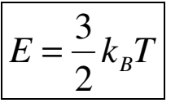
Prerequisite/Recapitulations
Classical free electron theory and its draw back
Classical Model:
The valence electrons in a solid are free to move anywhere in the metal in a way similar to gas molecules in a container. Therefore, the assembly of free electrons in a metal is called electron gas.
The electrical and thermal conductivities of the metals is solely due to free electrons
The electrons move randomly in all directions with random velocities following the classical Maxwell Boltzmann distribution. The average kinetic energy of a free electron is thus given by
Unlike gas molecules, the free electrons move in a background of immobile positive ions.
The free electrons make collisions from time to time with fixed positive ions. Between these collisions, the electron-ion interaction is neglected. This is called free electron approximation. Further electron-electron interaction is also neglected. This is called independent electron approximation

Slide 3
Prerequisite/Recapitulations
Classical free electron theory and its draw back
Classical Model:
Collisions in Drude model, as in kinetic theory, are instantaneous events that abruptly alter the velocity of an electron.
An electron experiences a collision with a probability per unit time 1/τ. This means that on the average an electron travels for time τ after it undergoes a collision and before its next collision i.e. the average time between two successive collisions is τ .This time is known as relaxation time (τ). The average distance traversed by a free electron between two successive collisions with positive ions is called the mean free path (λ).
In absence of external electric field, the random motion of free electrons is equally probable in all directions. As a result, there is no net current in the absence of electric field. When an external electric field is applied, the electrons are accelerated in a direction opposite to that of electric field.

Slide 4
Prerequisite/Recapitulations
Drawbacks of classical free electron theory
From the classical free electron theory the value of specific heat of metals is given by 4.5R, where ‘R’ is called the universal gas constant. But the experimental value of specific heat is nearly equal to 3R.
With help of this model we can’t explain the electrical conductivity of semiconductors or insulators.
The theoretical value of paramagnetic susceptibility is greater than the experimental value.
Ferromagnetism cannot be explained by this theory.
At low temperature, the electrical conductivity and the thermal conductivity vary in different ways. Therefore K/σT is not a constant. But in classical free electron theory, it is a constant in all temperature.
The photoelectric effect, Compton effect and the black body radiation cannot be explained by the classical free electron theory.

Slide 5
Objectives
After the completion of this lecture you will be able to:
Understand the quantum free electron theory
Explain the Wavefunction and its characteristics
Solve the problems based on wavefunction

Slide 6
Introduction
Basic assumptions of Quantum free-electron theory
The metal contains a large number of conduction electrons which are completely free yet are bound to the metal as a whole. Thus a metal is said to be consisting of electron gas.
The attractive force between core and the electron and the repulsion between the electron and electron is ignored.
The energy values of electrons are quantized as various allowed energy levels.
The distribution of electrons in these allowed levels takes place according to Pauli exclusion principle
The potential due to lattice ions is taken to be constant throughout the metal.
Free electrons in a metal can be described as free particles confined in a box of certain volume. The possible electronics states and the distribution of electrons in these states can thus be determined using quantum mechanics.

Slide 7
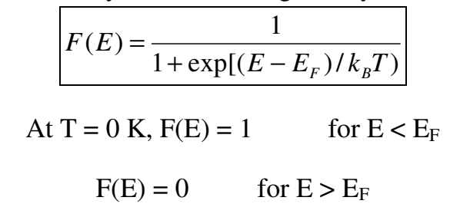
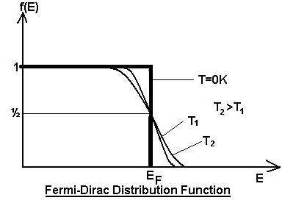
The Fermi-Dirac Distribution
The Fermi-Dirac distribution applies to fermions, particles with half-integer spin which must obey the Pauli Exclusion Principle. It gives the probability, F(E), for the occupation of a particular energy level E by an electron is given by
Where k_{B} is the Boltzmann's constant, T is the absolute temperature, E is the energy of the particular energy level E, and E_{F} is the Fermi energy
It can be seen that for T = 0, all the states up to energy EF are filled with electrons and all the states above EF are vacant. At E = EF the occupation probability is ½.
Thus the Fermi energy can be defined as the energy of the highest filled level at absolute zero. At a finite temperature, the electron may get the energy of order kBT and go to higher vacant state, and so

Slide 8
The Fermi-Dirac Distribution
the Fermi function falls. At any temperature T, when E = EF, F(E) = ½. This function is plotted for T = 0 K and for finite temperatures T1 and T2 with T1 < T2 in the Figure. The Fermi temperature TF and Fermi velocity vF are defined by following expressions: kBTF = EF i.e. TF = EF/ kB ½ mvF² = kBTF i.e. vF = (kBTF/m)^{1/2} For example, for sodium, EF = 3.2eV, This gives TF = 37100 K and vF = 1.1× 10⁶m/s

Slide 9
Applications of Fermi Energy
Fermi energy is used to separate the vacant and filled states at 0 K
It is used to know the status of the electrons.
Electrons are completely filled below fermi energy level and completely empty above the fermi level at 0 K
Above 0 K some electrons absorb thermal energy and they jumps to the higher energy levels.

Slide 10
Idea of wave function for quantum particle
Instead of two sets of physical principles in physics, one for the macroworld and one for the microworld, there is only the single set included in quantum mechanics.
The wavefunction attempts to describe a quantum mechanical entity (photon, electron, x-ray, etc.) through its spatial location and time dependence, i.e. the wavefunction is in the most general sense dependent on time and space:
Ψ = Ψ(x; t)
The state of a quantum mechanical system is completely specified by the wavefunction Ψ(x; t).

Slide 11

Idea of wave function for quantum particle
The Probability that a particle will be found at time t₀ in a spatial interval of width dx centered about x₀ is determined by the wavefunction as:
P(x₀; t₀) dx = Ψ∗(x₀; t₀)Ψ(x₀; t₀)dx = |Ψ(x₀; t₀)|²dx
Since the postulate of the probability is defined through the use of a complex conjugate, Ψ *, it is accepted that the wavefunction is a complex valued entity :
Ψ =A + iB
where A and B are real functions.
The complex conjugate Ψ * of Ψ is Complex conjugate Ψ * =A - iB and so
| Ψ |² = Ψ * Ψ= A² - i²B² = A² + B²
Hence | Ψ |² = Ψ * Ψ is always a positive real quantity, as required.
The probability of finding the particle between x1 and x2 is

Slide 12
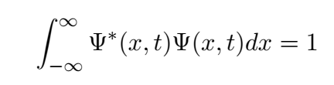
Characteristics for a suitable wavefunction
Characteristics for a suitable wavefunction-(Well-Behaved Wave Functions)
Since the probability of a particle being somewhere in space is unity, the
integration of the wavefunction over all space leads to a probability of 1.
That is, the wavefunction is normalized:
Every acceptable wave function can be normalized by multiplying it by an appropriate constant
In order for Ψ(x; t) to represent a viable physical state, certain conditions are required:
1. The wavefunction must be a single-valued function of the spatial
coordinates. (single probability for being in a given spatial interval)
2. The first derivative of the wavefunction must be continuous so that
the second derivative exists in order to satisfy the Schrodinger equation.
3. The wavefunction cannot have an infinite amplitude over a finite interval. This would preclude normalization over the interval.

Slide 13
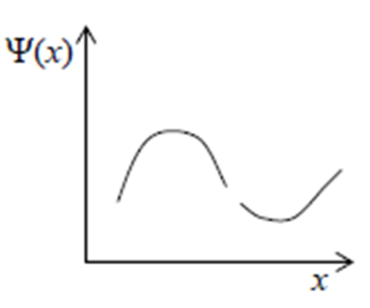
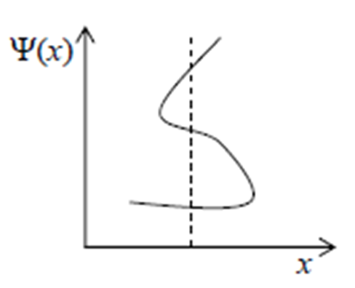
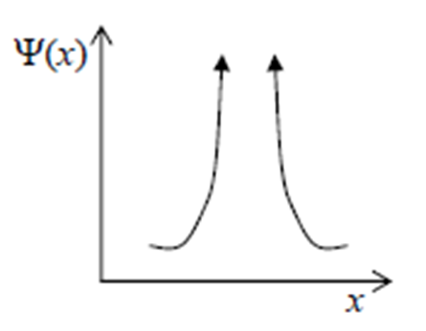
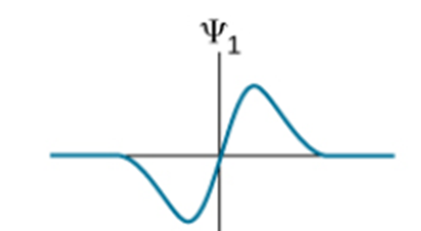
Problems
Problem 1: Acceptable or not acceptable wave function? Why?

Slide 14
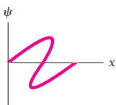
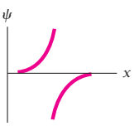
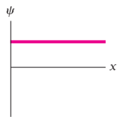
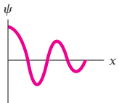
Problems
Problem 2: Acceptable or not acceptable wave function? Why?

Slide 15

Problems
Problem 3: A particle limited to the x axis has the wave function 𝞧 = ax between x = 0 and x =1; 0 elsewhere. (a) Find the probability that the particle can be found between x = 0.45 and x =0.55.
Solution:
The probability of finding the particle between x1 and x2 is
Therefore the probability is -

Slide 16
References
J. Singh , Semiconductor optoelectronics, Physics and Technology, Mc-Graw –Hill Inc.
S.O. Pillai , Solid State Physics, , New Age International (P) Ltd. Sixth edition, 2010.
S.M. Sze, Semiconductor Devices: Physics and Technology, Wiley 2008.
Introduction to Nanotechnology C P Poole, Frank J. Owens, John Wiley & Sons, 2011.
Introduction to Nanoscience and Nanotechnology, KK Chattopadhyay, A N Banerjee, Phi Learning Pvt Ltd., New Delhi, 2012.

